Slide 1
Ios workshop
MadE by PLT ios team ©2017

Slide 2
Agenda
iOS platform
XCODE
Application anatomy

Slide 3
iOS Platform
Phone models and resolutions
iOS version
Comparison with Android
Notes:
Runs on phones, tablets, watch and appletv

Slide 4
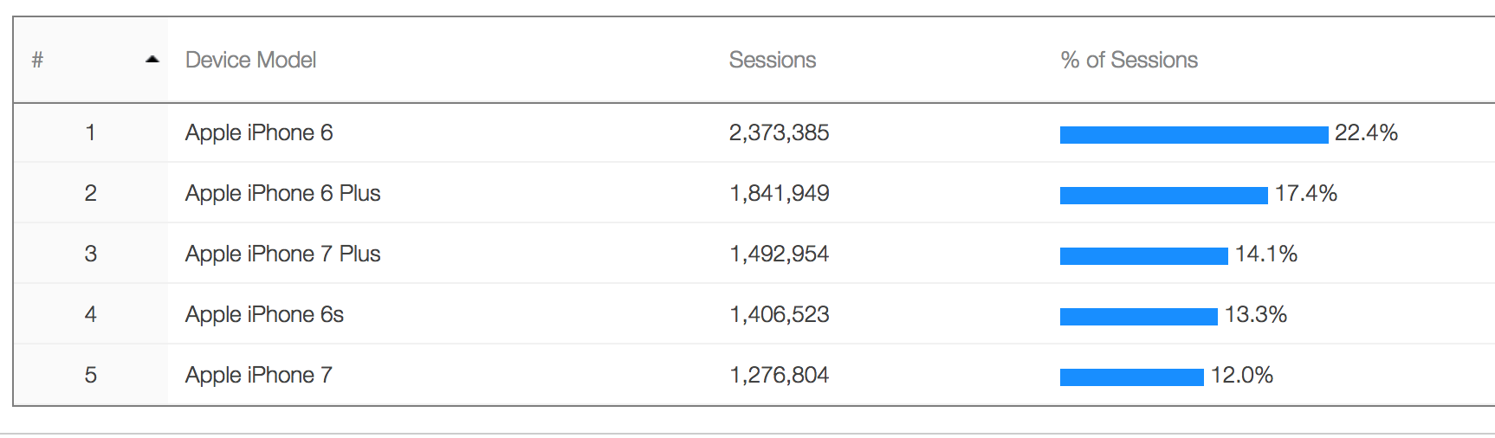
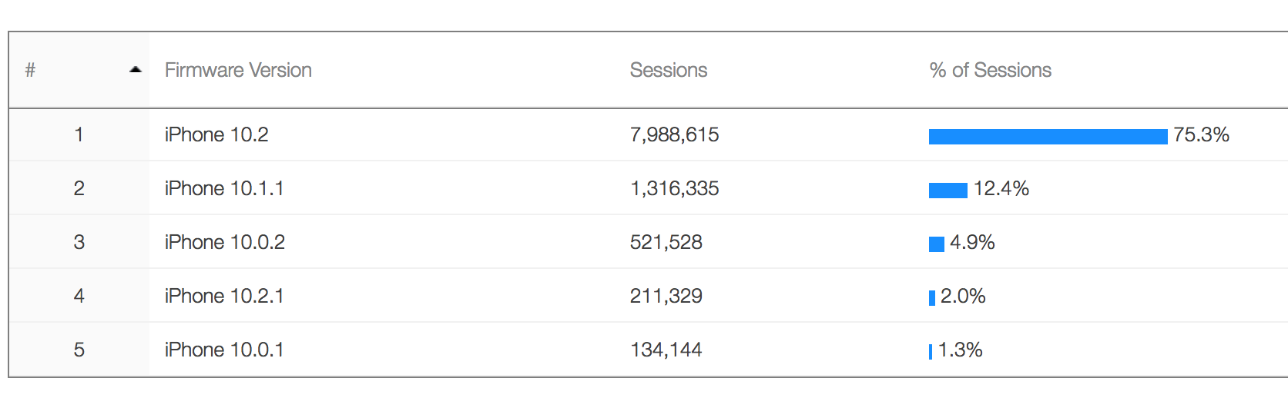
iPhone models
Notes:
Adoption rate is very high. New models very early become popular

Slide 5
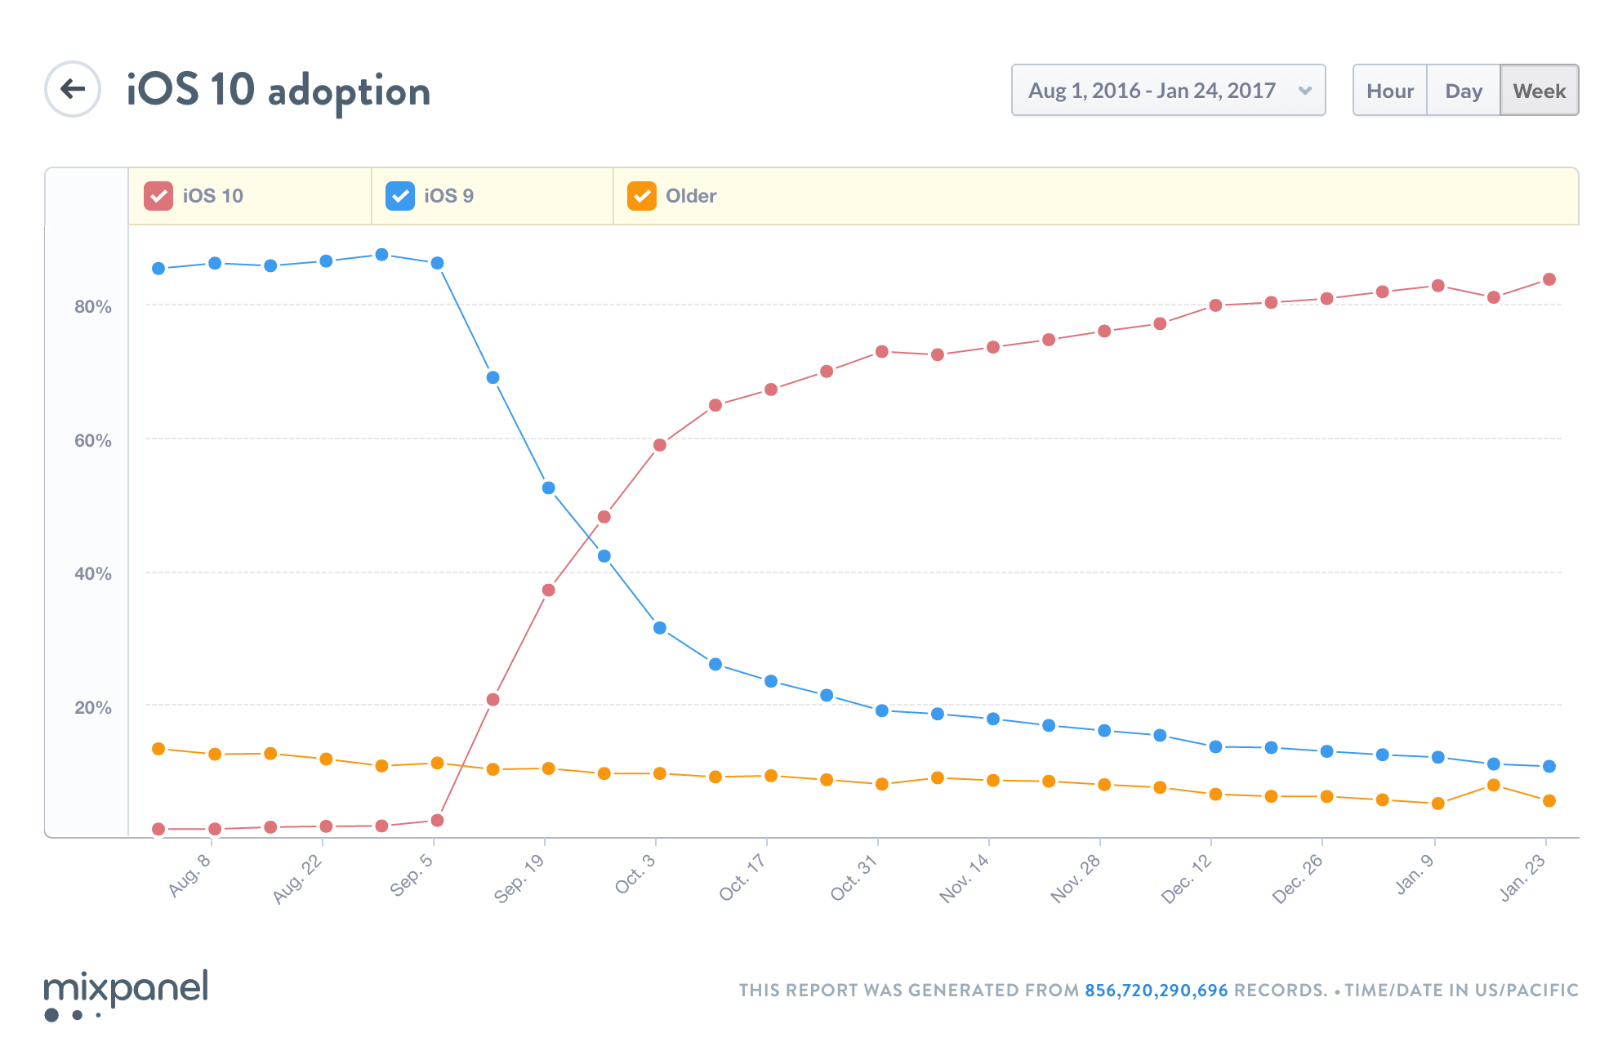
iOS version
Notes:
iOS10 gets momentum very fast

Slide 6
Whats new in ios 10
Siri integration
iMessanger
CallKit
Maps
Notes:
”biggest release ever”

Slide 7
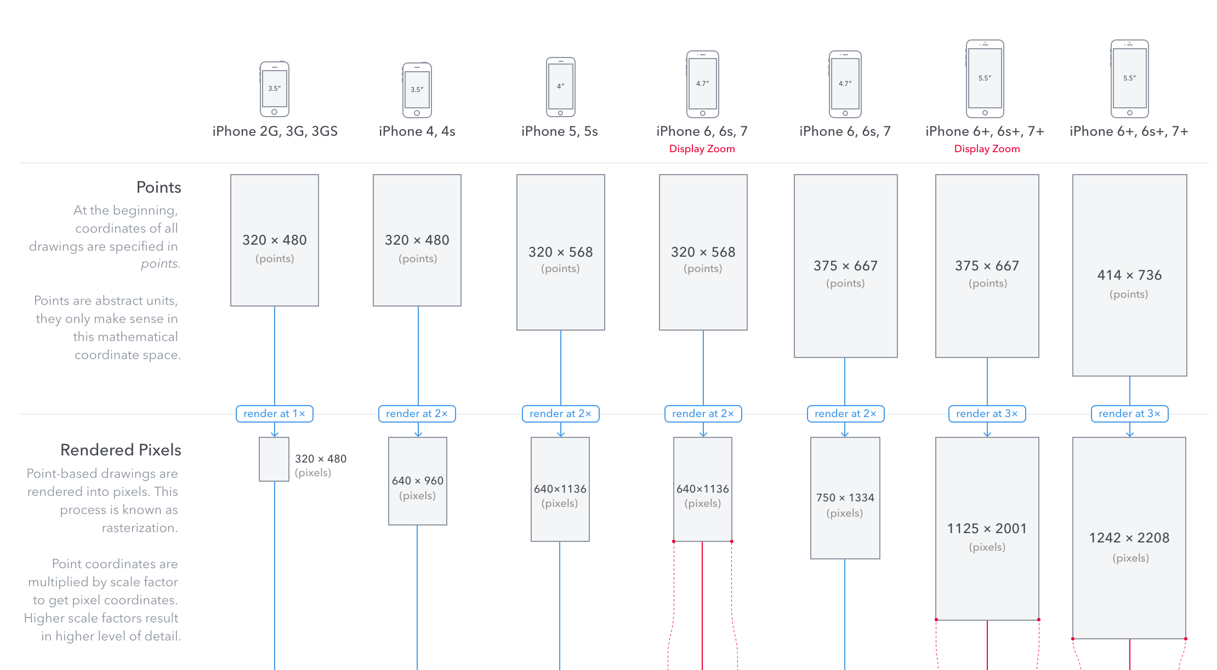
iPhone resolutions
Notes:
https://www.paintcodeapp.com/news/ultimate-guide-to-iphone-resolutions

Slide 8
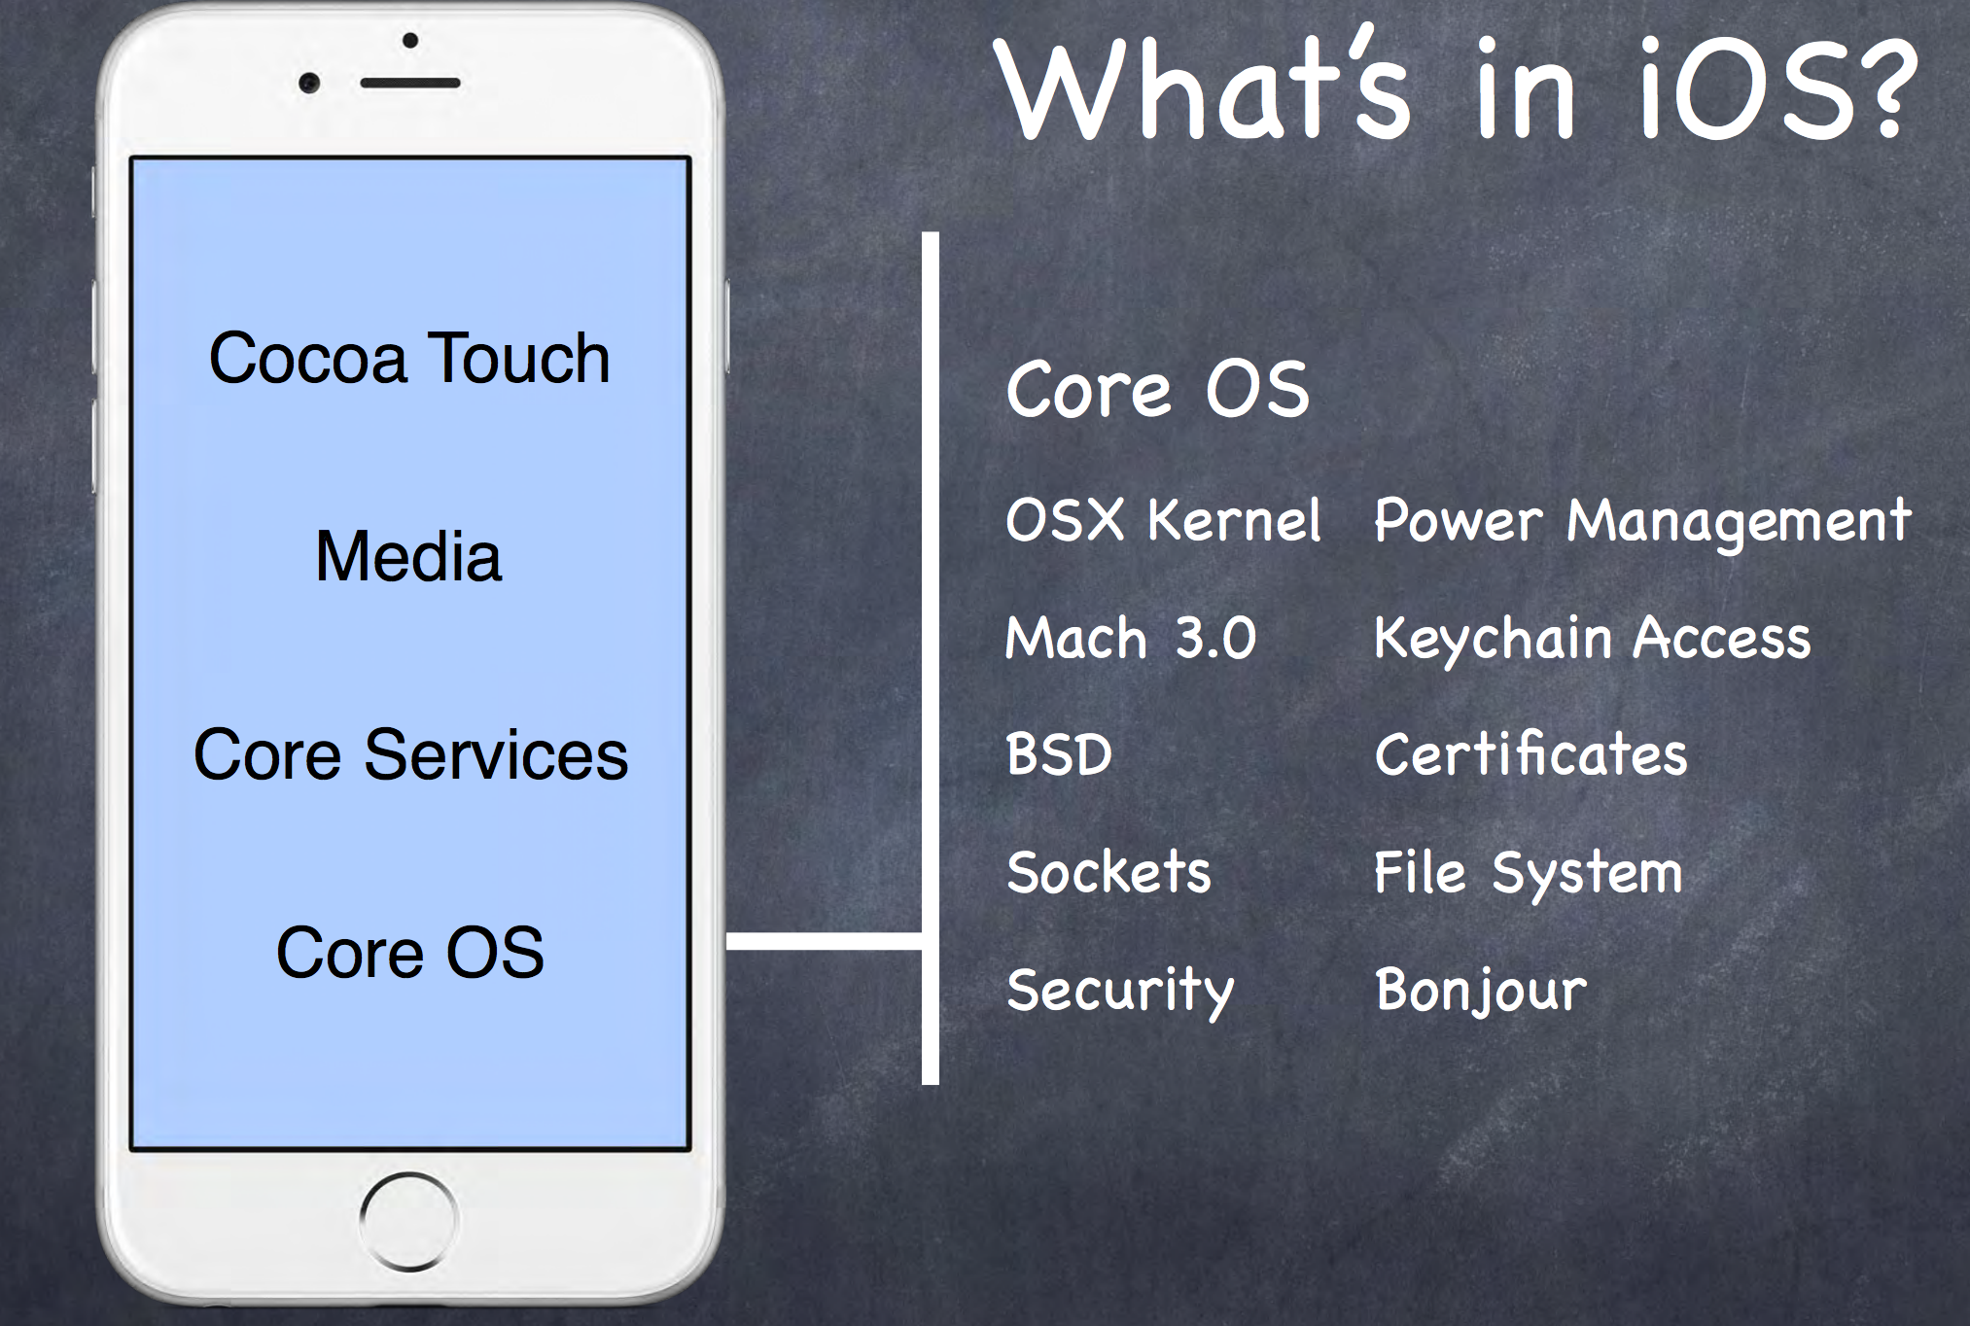
What is ios
Notes:
Unix based OS

Slide 9
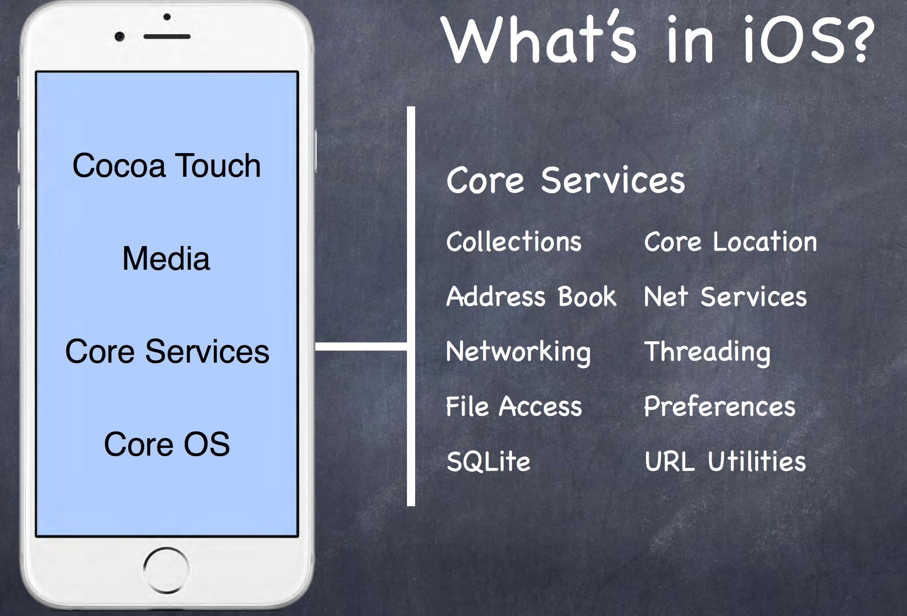
What is ios

Slide 10
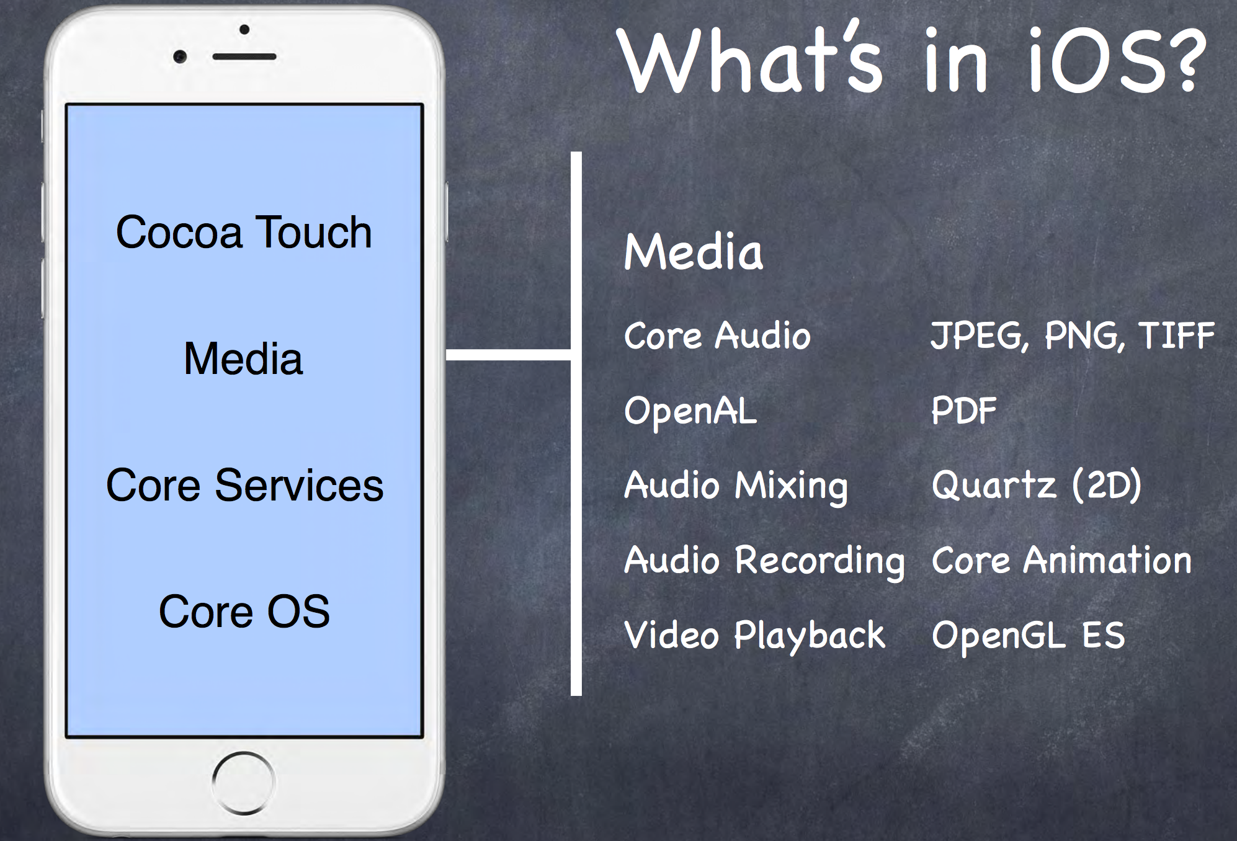
What is ios

Slide 11
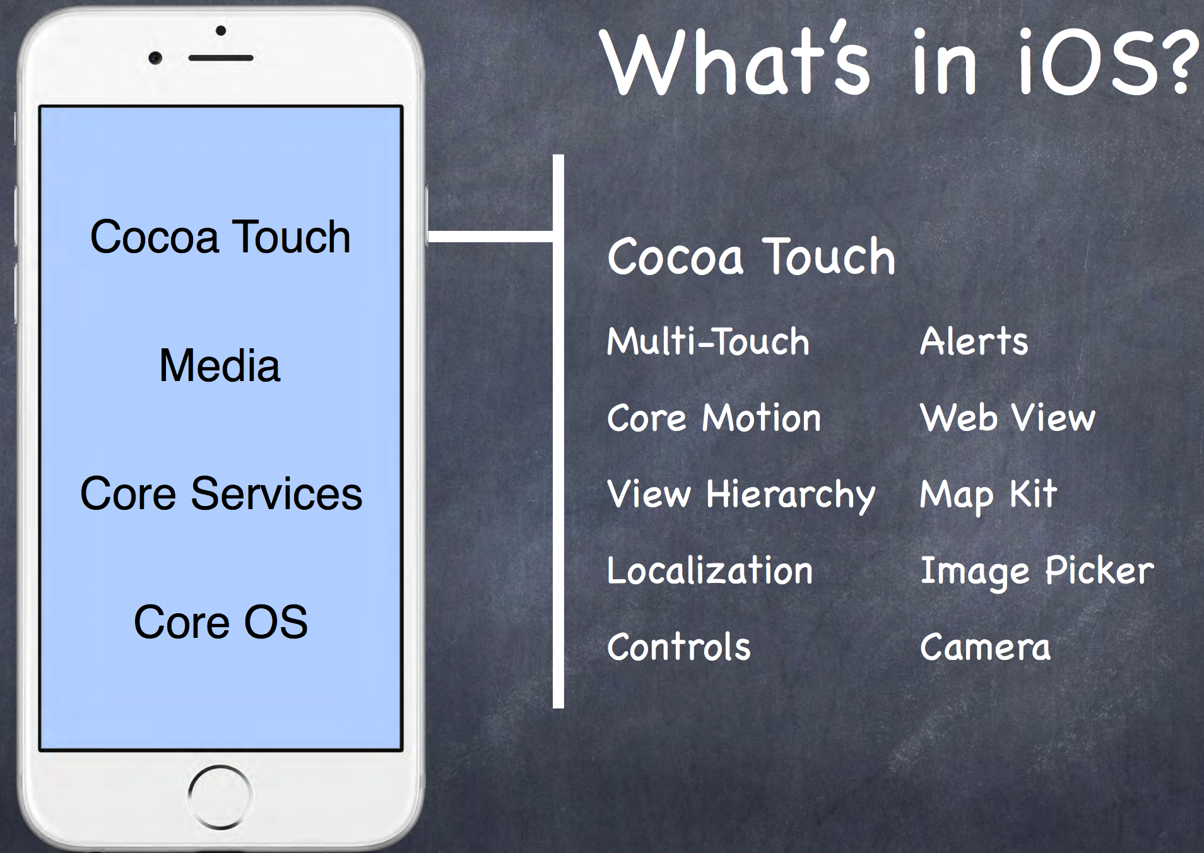
What is ios

Slide 12
ioS vs Android
iOS – 12.9% vs Android – 86.2%
App Store 2M vs Google Play Market 2.2M
App store 2x less downloads 2x bigger revenue
App developers earned $20 billions in 2016
Notes:
OS 2.0.1 with App Store support
App store apple:
developer gets 70 percent of the sales of the app. Or 85 if user stays subscribed for a year to app
Hard review process
Major cleanup announced of zombie apps.

Slide 13
Agenda
iOS platform
XCODE
Application anatomy

Slide 14
XCODE IDE
XCode and Instruments
Options: Playground, Project, Workspace
Project templates
Navigation, Editor, Utility areas
Debugger
Simulator
Notes:
XCode IDE, prolazak kroz ekrane. Instruments.
Kreiranje novog projekta I workspace-a. Prolazak kroz boilerplate kod I fajlove. Project settings, build targets.
Kreirati Objective-C projekat. Show main function
Debugger and breakpoints. Console log
Simulators

Slide 15
Agenda
iOS platform
XCODE
Application anatomy

Slide 16
Application anatomy
Application runs in sanbox
IPA an APP files
Build outputs
Notes:
What is application. Compiled in .ipa format (zip) contains binaries for ARM, so can run only on real device. Simulators are on different architecture x86
Applications don't have access to underlying filesystem , and only have access to application sandbox :
Bundle container with MyApp.app. Signed on installation time
Documents
Applications can be only installed from App Store. With valid Apple ID. To publish applications to App Store you need enroll to Apple Developer Program https://developer.apple.com/support/compare-memberships/

Slide 17
Application lifecycle
application:willFinishLaunchingWithOptions
application:didFinishLaunchingWithOptions
applicationDidBecomeActive
applicationWillResignActive
applicationDidEnterBackground
applicationWillEnterForeground
applicationWillTerminate
Notes:
Apps are expected to launch, initialize themselves, and start handling events in less than 5 seconds

Slide 18
DEMO
Notes:
iOS 4 introduced “multitasking”
Way to execute specific tasks while in background.

Slide 19
Application background
Multitasking in iOS
Application capabilities in background
Notes:
iOS 4 introduced “multitasking”
Way to execute specific tasks while in background.

Slide 20
Audio and AirPlay | audio | The app plays audible content to the user or records audio while in the background. (This content includes streaming audio or video content using AirPlay.) The user must grant permission for apps to use the microphone prior to the first use; for more information, see Supporting User Privacy.
Location updates | location | The app keeps users informed of their location, even while it is running in the background.
Voice over IP | voip | The app provides the ability for the user to make phone calls using an Internet connection.
Newsstand downloads | newsstand-content | The app is a Newsstand app that downloads and processes magazine or newspaper content in the background.
External accessory communication | external-accessory | The app works with a hardware accessory that needs to deliver updates on a regular schedule through the External Accessory framework.
Uses Bluetooth LE accessories | bluetooth-central | The app works with a Bluetooth accessory that needs to deliver updates on a regular schedule through the Core Bluetooth framework.
Acts as a Bluetooth LE accessory | bluetooth-peripheral | The app supports Bluetooth communication in peripheral mode through the Core Bluetooth framework. Using this mode requires user authorization; for more information, see Supporting User Privacy.
Background fetch | fetch | The app regularly downloads and processes small amounts of content from the network.
Remote notifications | remote-notification | The app wants to start downloading content when a push notification arrives. Use this notification to minimize the delay in showing content related to the push notification.

Slide 21
DEMO
Notes:
iOS 4 introduced “multitasking”
Way to execute specific tasks while in background.

Slide 22
Application Signing
Provisioning profile
Application development portal
iTunes connect
Example: Sonic Amarra
Notes:
Application development portal
Application signing
iTunes Connect and Ammara

Slide 23
RESOURCEs 1
App signing
https://www.raywenderlich.com/127936/submit-an-app-part-1
https://www.raywenderlich.com/127939/submit-an-app-part-2
Background mode and lifecycle
https://developer.apple.com/library/content/documentation/iPhone/Conceptual/iPhoneOSProgrammingGuide/BackgroundExecution/BackgroundExecution.html#//apple_ref/doc/uid/TP40007072-CH4-SW1
https://developer.apple.com/library/content/documentation/iPhone/Conceptual/iPhoneOSProgrammingGuide/StrategiesforHandlingAppStateTransitions/StrategiesforHandlingAppStateTransitions.html

Slide 24
Resources 2
https://developer.apple.com/videos/wwdc2016/
https://developer.apple.com/ios/human-interface-guidelines/overview/design-principles/
https://developer.apple.com/develop/
https://developer.apple.com/swift/resources/
https://itunes.apple.com/book/swift-programming-language/id881256329?mt=11
https://itunes.com/StanfordSwift
https://github.com/duliodenis/cs193p-Spring-2016
https://www.raywenderlich.com/
https://www.amazon.com/Swift-Programming-Ranch-Guide-Guides/dp/013461061X

